Slide 2
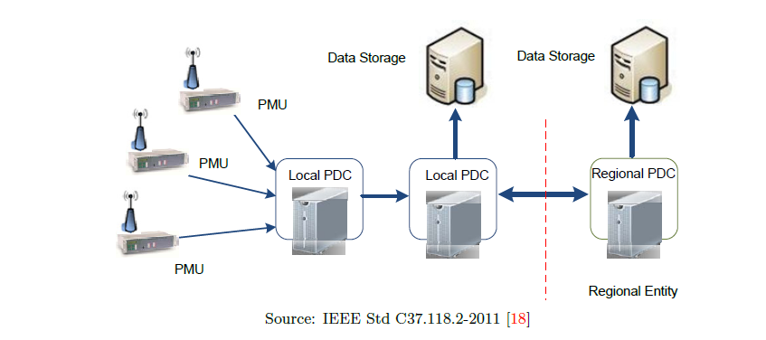
Introduction to Wide Area protection (WAPS).
Presented by : fathy wahed

Slide 3
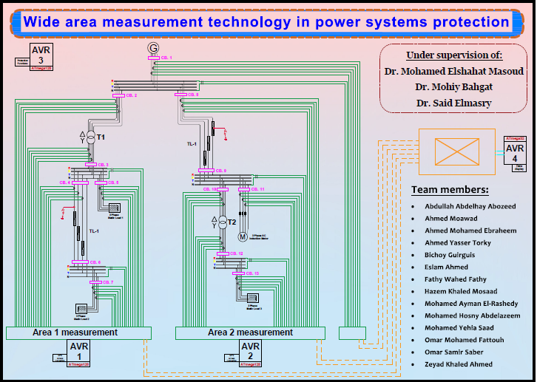
Our project is divided into two main parts:
A- hardware.
B- software.

Slide 4
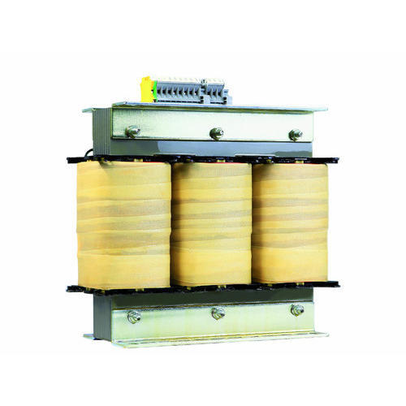
A- hardware divided into :
A- 2 transformers 1.5 MVA :
- We used two transformers that convert the voltage from 380 to 220 volts by a delta connection to a star connection .
- We used the transformers in this MVA to cope with the loads and transmission lines manufactured for this project .

Slide 5
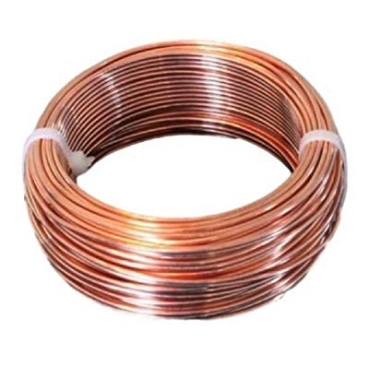
B- 2 Transmission lines :
For the first transmission line the length of the wire is 115 meters and the number of rolls is 332 lps, while it consists of four layers, the DC resistance is equal to 1.7 ohm , and the impedance equals 2.5 ohm , And thus L equals 0.0079577 Henry .
For the second transmission line the length of the wire is 90 meters and the number of rolls of the transformer is 285 rolls, while it consists of three layers, DC resistance equals 2.3 ohm, and impedence equals 3.749 ohm , And thus L equals 0.01193 Henry .

Slide 6
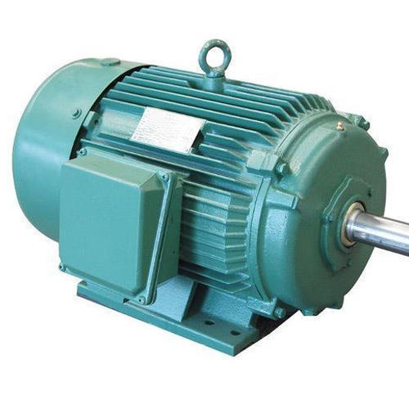
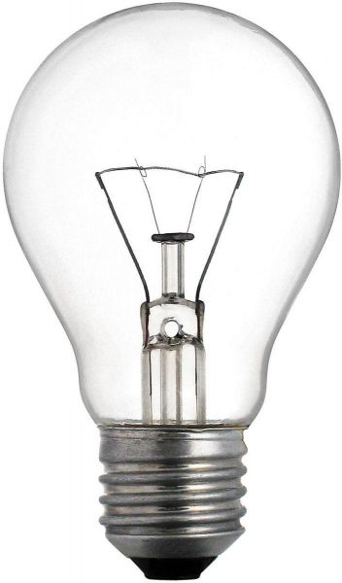
C- 1 three phase induction motor :
- The name of the motor run on 380 volts, rated current has 2 amperes, its capacity is 1 hp .
D- 3 static loads :
- The three static loads have the same power 610 watt.
- Each phase of static load was represented by three lamps with 247-ohm , and to achieve the required resistance equal to 82 ohms , each phase was connected to three parallel lamps .
- All of the above has been done in each phase of three phase of three static loads .

Slide 7
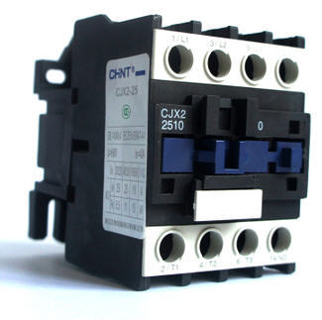
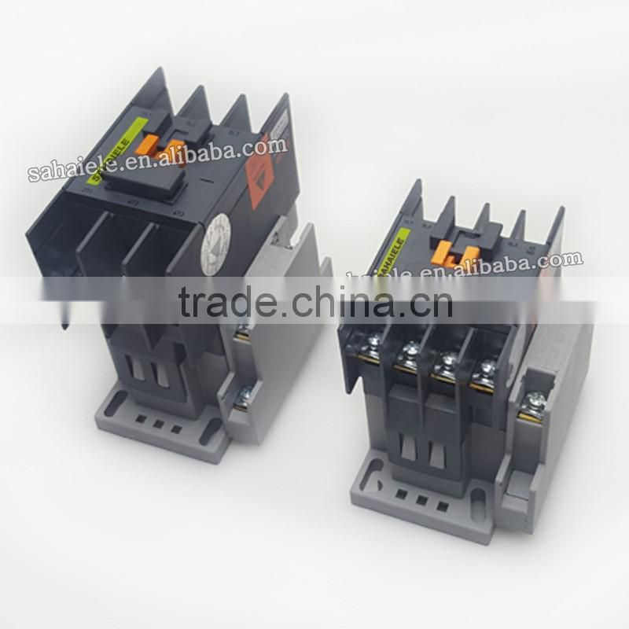
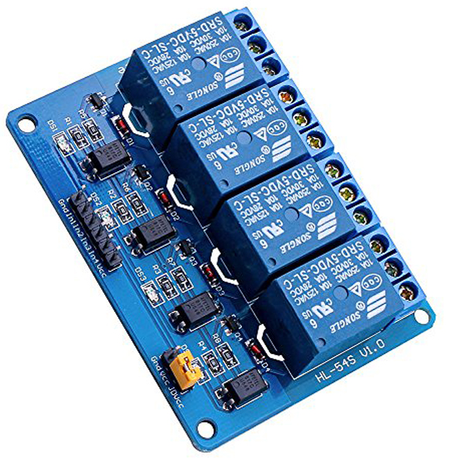
E- 5 three phase contactors :
- 380 volt and 9-ampere were used .
F- 7 three phase contactors :
- 220 volt and 9 ampere were used .
G- We used a kit relay to contact with the contactor and connect the kit with micro controller (ATMEGA 128) .

Slide 8
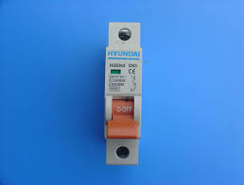
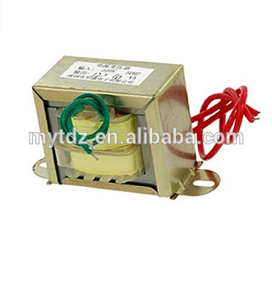
H- we used a three circuit breakers:
- single phase to each phase
before the slag bus 220 volt , 6 ampere .
I- We used 2 voltage transformers convert 400 volt to 5 volt and used 3 voltage transformers convert 250 volt to 5 volt each one installed of each BUS-BAR .

Slide 9
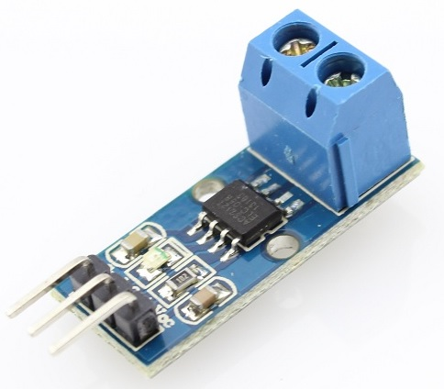

J- We used 36 single phase current sensors:
30 ampere in our project to sense the current and connected with the part of communication .
H- We used 20 Aluminum BUS-BARS on our Graduation project and we used it as collection point .

Slide 10
A- software divided into :
A- 2 microcontroller ( work as a PMU ) .
- They are devices which use synchronization signal from the global positioning system(GPS) satellite and provide the phasor voltage and currents measured at a given substation.
- A phasor is a complex number that represents both magnitude and phase angle of the sine waves found in electricity.
B- 1 microcontroller (work as a PDC ) .
- It is node in a system where phasor data from a number of PMUs or PDCs is correlated and fed out as a single stream to other applications. - PDC would performs the Real time monitoring, alarming, event triggering.

Slide 11
C- human machine interface (HMI):
- We represent it as a touchscreen to display the readings of the system .
D- 1 microcontroller (work as protection function) :
- It is possible to take reads of voltage and current from VT and CS or PMU .
- Note -
-- All the microcontrollers used in the project are ATMEGA128 and this type contains an A / D converter inside it --

Slide 12
How does it work ???????
- The project contains 2 PMUs and each one for one area .
- Its advantage is that it synchronizes the data by time, it is biased by GPSmodule in certain time, then DATA follows the PDC, which collects the data and sends it to the HMI as a display .
-The microcontroller which work as protection functionis read voltage and current And on its basis if fault happen ,it send a signal to kit relay to open the contactor that the fault happen on it .
- Touch screen shows the location of the fault and shows its value

Slide 13
Phasor measurement unit
Muhammed Hosni AbdelAzem

Slide 14
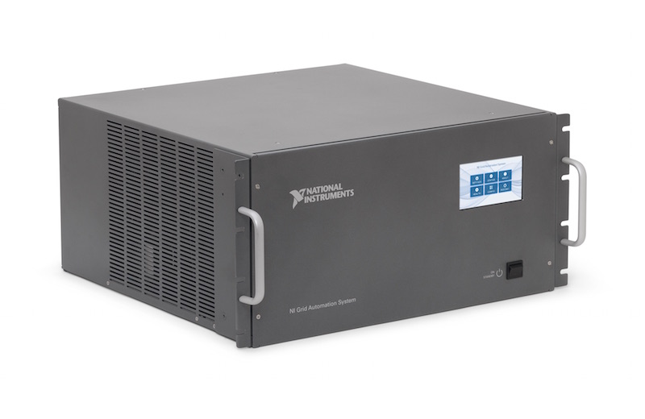
PMU:
Def :A phasor measurement unit (PMU) is a device used to estimate the magnitude and phase angle of an electrical phasor quantity (such as voltage or current) in the electricity grid using a common time source for synchronization. Time synchronization is usually provided by GPS and allows synchronized real-time measurements of multiple remote points on the grid. PMUs are capable of capturing samples from a waveform in quick succession and reconstructing the phasor quantity, made up of an angle measurement and a magnitude measurement. The resulting measurement is known as a synchrophasor. These time synchronized measurements are important because if the grid’s supply and demand are not perfectly matched, frequency imbalances can cause stress on the grid, which is a potential cause for power outages.
PMUs can also be used to measure the frequency in the power grid. A typical commercial PMU can report measurements with very high temporal resolution in the order of 30-60 measurements per second. This helps engineers in analyzing dynamic events in the grid which is not possible with traditional SCADA measurements that generate one measurement every 2 or 4 seconds. Therefore, PMUs equip utilities with enhanced monitoring and control capabilities and are considered to be one of the most important measuring devices in the future of power systems. A PMU can be a dedicated device, or the PMU function can be incorporated into a protective relay or other device.

Slide 15
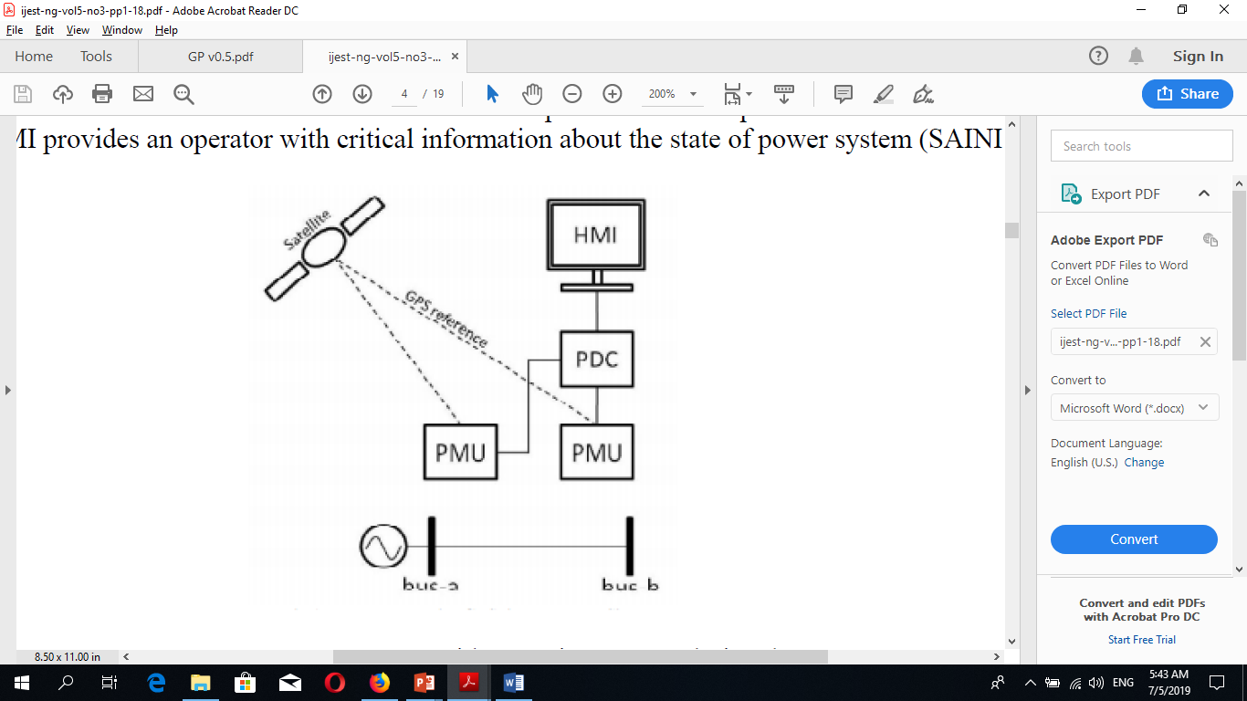
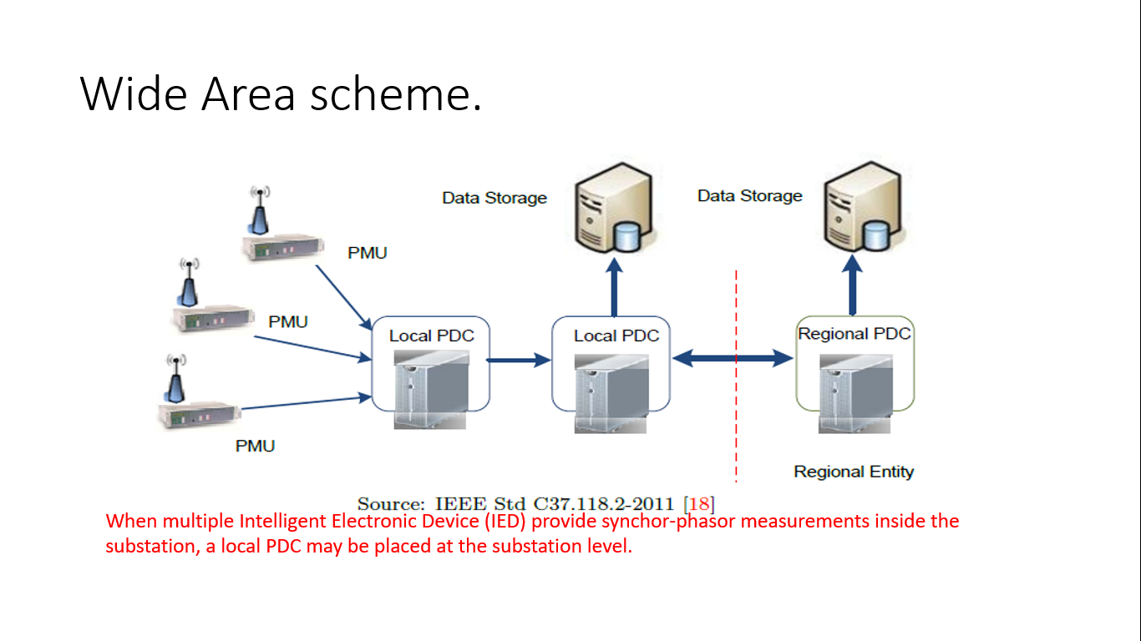
In The Same Way …

Slide 16
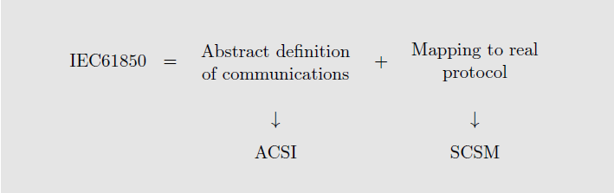
IEC 61-850 Standard
International Electrotechnical Commission's (61-850) : is an international standard defining communication protocols for intelligent electronic devices (IEDS) at electrical substations . The abstract data models defined in IEC 61850 can be mapped to a number of protocols. Current mappings in the standard are to MMS (Manufacturing Message Specification), GOOSE (Generic Object Oriented Substation Event), SMV (Sampled Measured Values), and soon to Web Services. These protocols can run over TCP/IP networks or substation LANs using high speed switched Ethernet to obtain the necessary response times below four milliseconds for protective relaying.

Slide 17
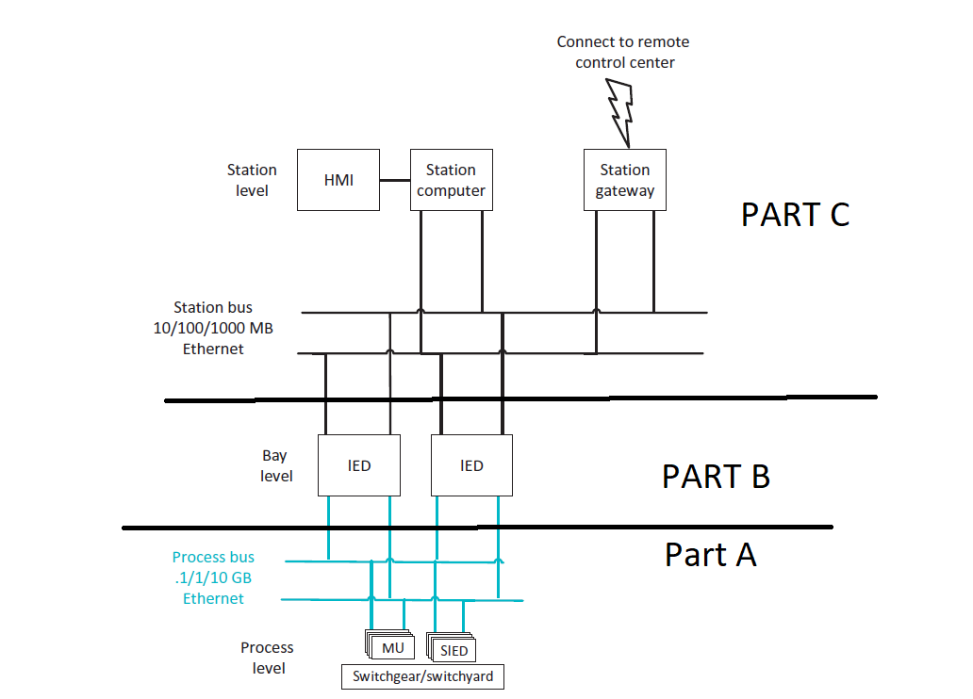
IEC 61-850 In Side Substation

Slide 18
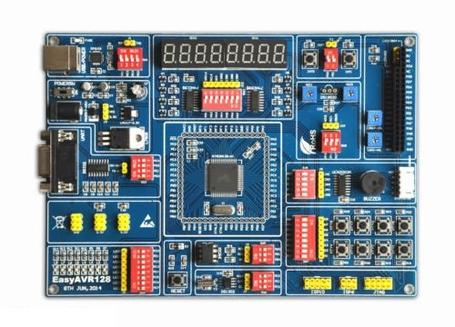
HOW We Implementation IEC61-850 Standard in our Project ?
our project consist of IEDS Which have different Function , however Just Two micro controller (at mega 128) act as Pmu which programmed To Receive Data From current sensors and voltage transformer , Then transfer This measurement To Samples Value Which Schynrozied by universal time constant which produced synchro-phsor data .(real Time data ) .
Atmega 128 micro controller

Slide 19
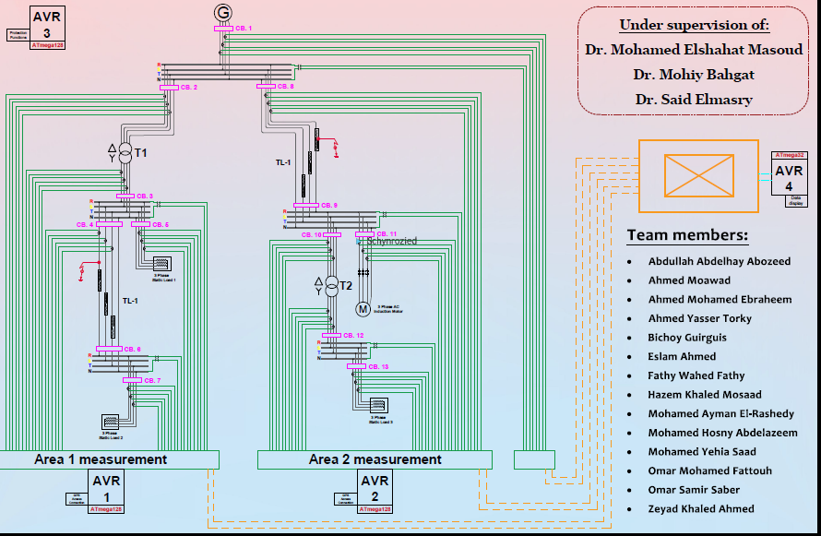

Slide 20
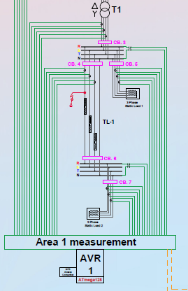
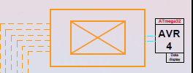
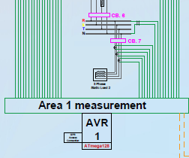
PMU of Area 1
As show in fig The AVR(1) act as Pmu which Receive
Data and Send synchrophsor Value To PDC Via Ethernet connection
PDC
Direct connection of C.S and V.T

Slide 21
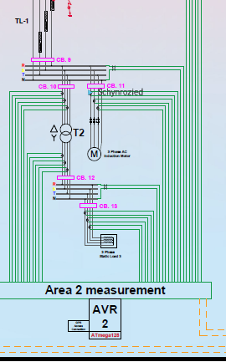
PMU Of Area (2)
The AVR(2) act as pmu which send syncro-phsor data via protocol of standard 61-850-90-50
AND IT Will Presented BY :
Abdullah Abdelhai
Bichoy Gurigus

Slide 22
Phasor Data Concentrator (PDC)
A phasor data concentrator collects phasor data from multiple PMUs or PDCs
It alligns the data using time-tag to create a time-synchronized dataset
It passes this data to other information system
It also performs data quality checks

Slide 23
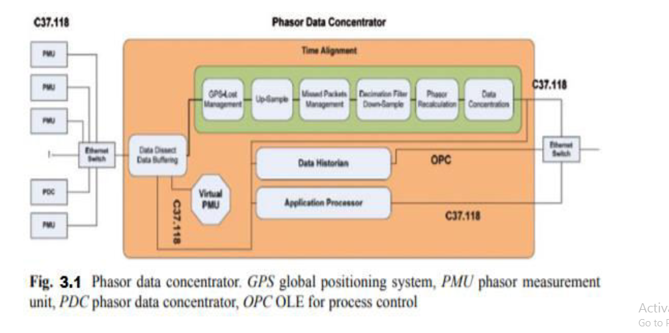
Phasor Data Concentrator (PDC)

Slide 24
Phasor Data Concentrator (PDC)
PDC store phasor data so it can be used in applications with slower sample rates such as Supervisory control and data acquisition (SCADA)
The real-time data broadcasting capability enables us to make us of aligned time data
Each measurement carries a precise time stamp take from GPS module so that the entire system can be analyzed at any moment

Slide 25
PDC levels
The function of PDC can vary depending on its role between PMUs, There are 3 levels of PDC as shown below
Local PDC
Corporate PDC
Super PDC

Slide 26
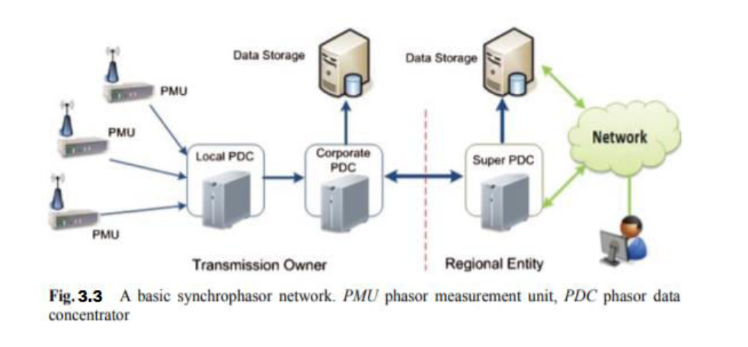
PDC Levels

Slide 27
Application
In our project we used AT mega 128 microcontroller as a PDC
Its illustrated as AVR(3) which stores phasor data from the PMUs [AVR(1) and AVR(2)] and transmit them to the HMI (Human machine interface) smart screen to view the current and voltage synchronized measurements

Slide 28
Transfer outside of the substation

Slide 29
In IEC 61850, SV,GOOSE services data is inside substation ,these communication protocols are over Ethernet inside a substation.

Slide 30
There are two options introduced :
1) Internet Protocols (IP) networks (UDP/TCP)
In this mechanism, SV and GOOSE services are communicated via IP networks.
Used when if the delays of the communication network are acceptable for particular WAMPAC applications.
2)Tunneling
SV, GOOSE is tunneled across some high speed communication networks (Fiber Optics).
Very High Speed.

Slide 31
Protocols uses across the internet
TCP/IP Stands For : Transmission Control Protocol. requires a handshake in which the receiver agrees to the communication before the data is sent. Data sends in chuncks. | UDP/IP User Datagram Protocol. Not requires a handshake.

Slide 32
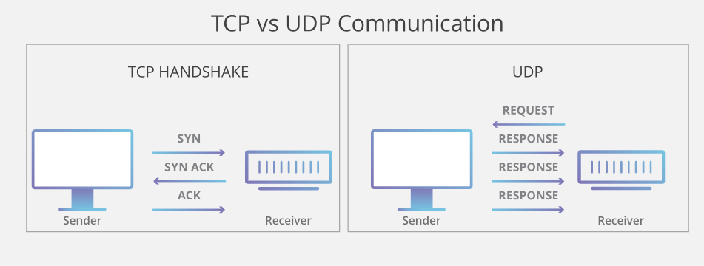

Slide 33
But in our project we simulate the internet protocol by using radio frequency to transmit the data from the PMU to PDC.
And we simulate the fiber optics by 8 wires (8bit) to transmit the data from PMU to PDC and that’s faster in time than the first method.

Slide 34
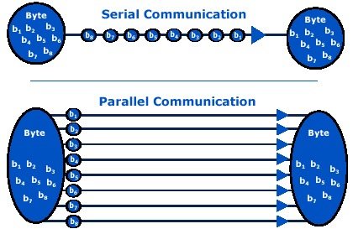
Comparison between sending data in serial communication and parallel communication:

Slide 35
Serial communication:
The advantage of serial communication (internet protocol) method is that it doesn’t need a lot of wires to transmit the data.
The disadvantage is that the data needs long time to be transmitted.

Slide 36
Parallel communication:
The advantage of parallel communication(Fiber Optics) is that the data is transmitted at the same time(very fast).
The disadvantage of parallel communication is that it needs a lot of wires.

Slide 37
Wirless Module
.

Slide 38
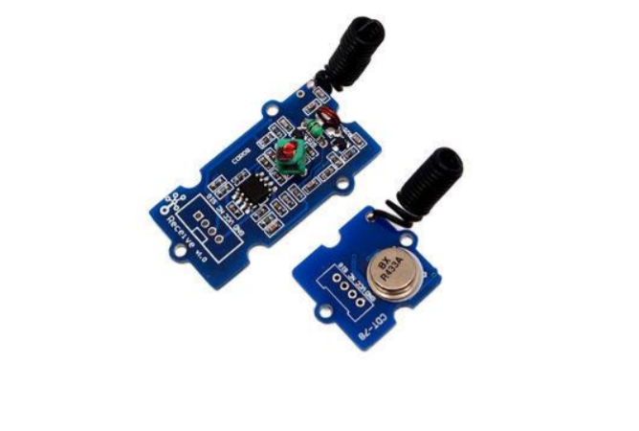
Wirless Transmitter – Reciever RF 433 MHZ

Slide 39
.
Introduction
This kit is used for one way wireless communication at a frequency of 433MHz and includes
transmitter module and a receiver module. The twig configuration of this kit allows for around 40 meters of transmitting distance indoors, or around 100 meters outside.

Slide 40
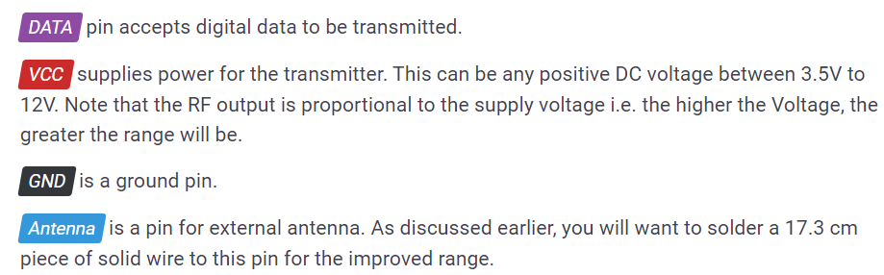
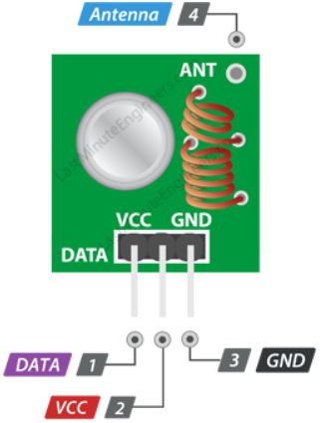
.
Configuration
Transmitter Kit
Transmitter frequency range 433.92MHz

Slide 41
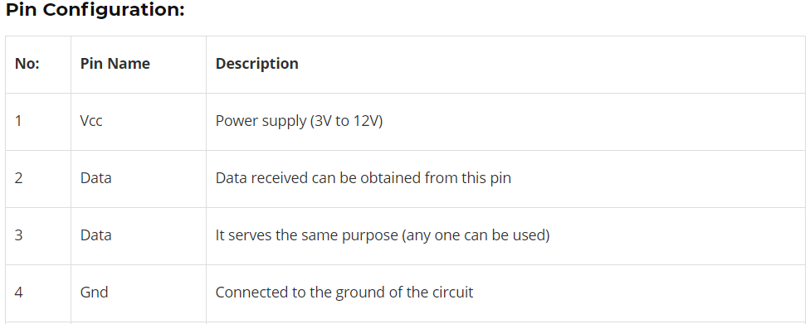
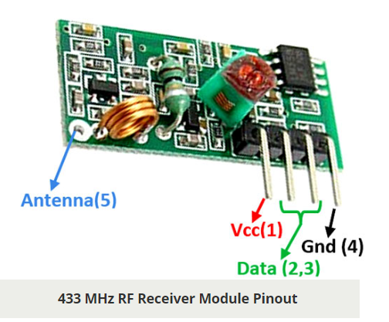
.
Reciever Kit
Receiver frequency 433MHz
Receiver supply current 3.5mA
Low power consumption

Slide 42
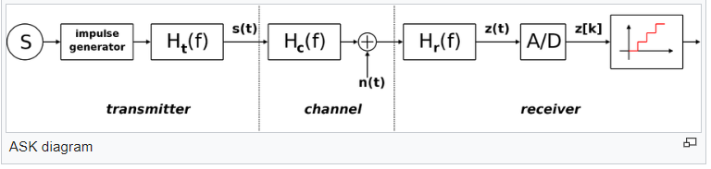
.
Features
1) Modulating Technique: ASK (Amplitude shift keying)
is a form of amplitude modulation that represents digital data as variations in the amplitude of a carrier wave.
ht(f) is the carrier signal for the transmission
hc(f) is the impulse response of the channel
n(t) is the noise introduced by the channel
hr(f) is the filter at the receiver

Slide 43
.
2) GROVE compatible interface
The Grove System is a physical standardization of various electrical interfaces including but not limited to I2C, SPI, UART, GPIO, and analog connections.
In our Project we use UART Interface.
3) One way communication
In one-way communication, information is transferred in one direction only, from the sender to the receiver. There isn't any opportunity for the receiver to give feedback to the sender.

Slide 44
.
Applications
Wireless security systems
Car alarm systems
Remote controls
Sensor reporting
Automation systems

Slide 45
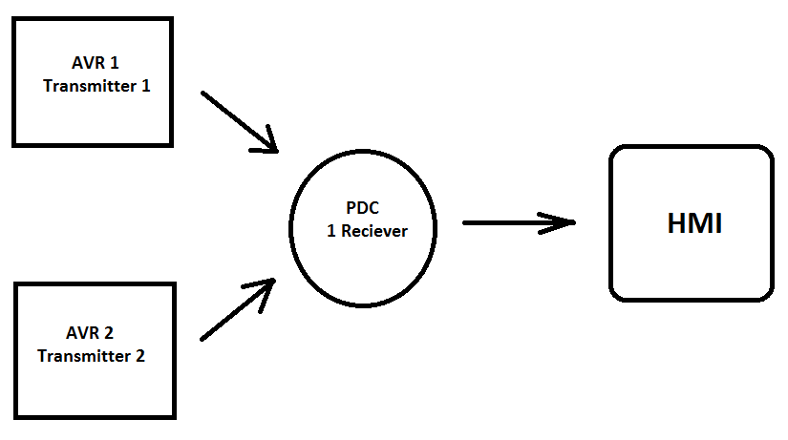
.
Usage
In our project we have 2 Transmitter and 1 reciever

Slide 46
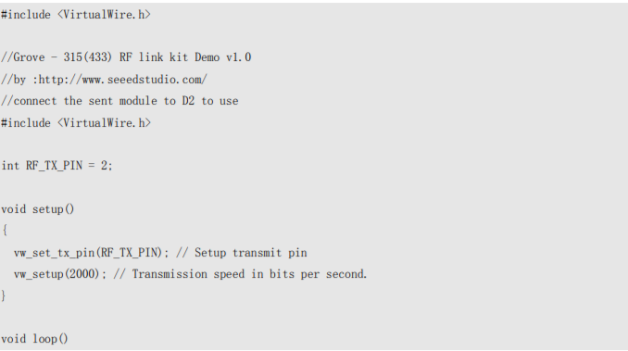
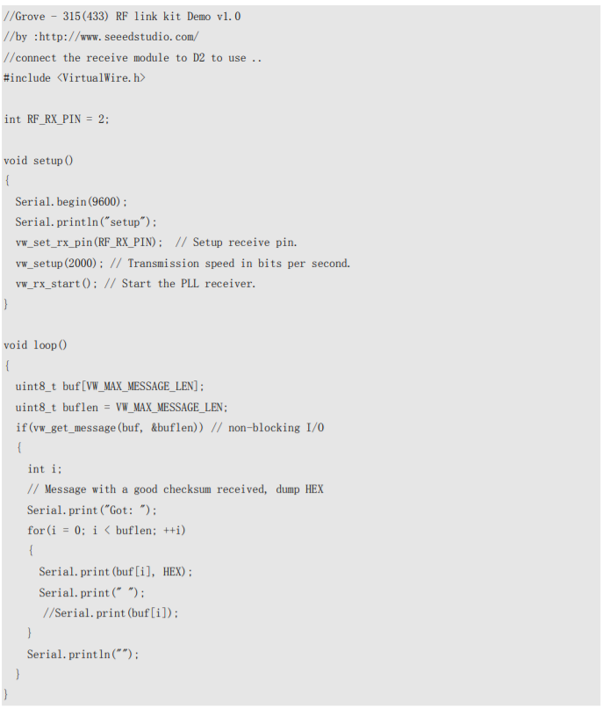
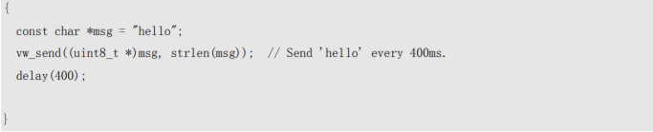
.
Coding
Upload the code below for transmitter module Upload the code below for receiver module:

Slide 47
Time delay In Wide Area.
Presented By : Hazem Khaled.

Slide 48
Causes of Time delay in wide area from our perspective :
Sensors.
ADC.
Algorithm.
Communication.
IEC 61850-90-5.
Frame according to IEC 61850-90-5.
Frame used in our project.
Wireless-Kit vs parallel transmission.

Slide 49
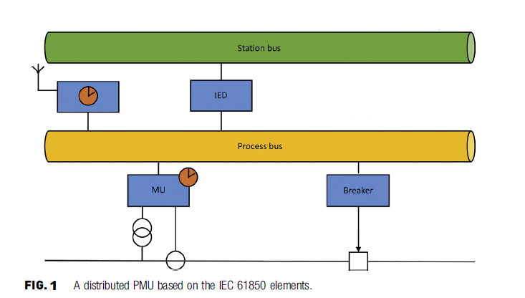
Distributed PMU.

Slide 50
Sensors:
Classification INSTRUMENT TRANSFORMERS (ITs) in two classification :
“conventional” ITs, which include all the ITs proper—that is, inductive CTs, inductive VTs,and capacitive VTs.
low-power instrument transformers (LPITs).
which are “intended to , transmit a low-power analog or digital information signal to measuring instruments, meters and protective or control devices or similar apparatus.” LPITs, LPITs, whose output is a voltage, are further divided into
active LPITs and passive LPITs.
Example : Linear Coupler,Voltage dividers, Hall-effect-based current transducers belong all to this group.

Slide 51
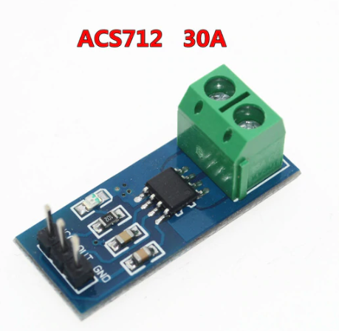
Current Sensor Used in our project:

Slide 52
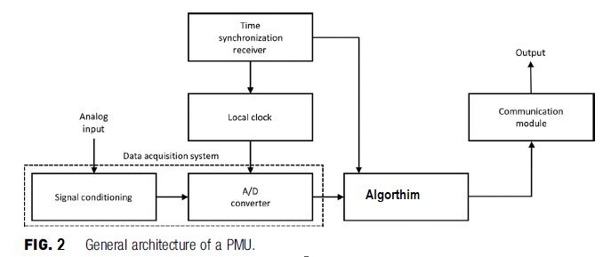
PMU Architecture :

Slide 53
Signal Conditioning ?
Signal Conditioning : Signal conditioning is the manipulation of a signal in a way that prepares it for the next stage of processing.
We use ACS712 Current Sensor which it’s output from :
0 – 2.5 Volt in DC.
2.5 – 5 volt in AC.
So In our project we reduce time by using current sensor which output is voltage, and suitable for ADC Processing.

Slide 54
Time Conversion in ADC?
Conversion Time : Time it takes the ADC To Convert the analog input to digital, This time depend on the algorithm used in ADC.
The conversion time is maintained constant in successive approximation type ADC, and is proportional to the number of bits in the digital output.
According to IEC-61850 Merging unit element it’s used successive approximation (SAR) method which have the following characteristic :
Constant time.
High Efficiency.
(SAR) Based on comparison.
In our project we used the same algorithm used in the standard.
As we Explain the topic from point of view of a Time let’s explain it.

Slide 55
Conversion time in (SAR) depend on :
Number of bits (Resolution).
Rules of Conversion :
The MSB is initially set to 1 with the remaining three bits set as 000. The digital equivalent voltage is compared with the unknown analog input voltage.
If the analog input voltage is higher than the digital equivalent voltage, the MSB is retained as 1 and the second MSB is set to 1.
Otherwise, the MSB is set to 0 and the second MSB is set to 1. Comparison is made as given in step (1) to decide whether to retain or reset the second MSB.

Slide 56
Example :
If we have analog input equal to 4 V and we want to convert it to digital value,
And we have ADC 4-bit resolution so the following will happen :
1000 which is (8 in decimal) > 0100 (4 in decimal) .. So right shift one step.
100 which is (4 in decimal) == 0100 (4 in decimal) .. We find the solution .. Add one 0110(6 in decimal).
0110 ( 6 in decimal ) > 0100 ( 4 in decimal ) .. So right shift one step.
0101 ( 5 in decimal ) > 0100 ( 4 in decimal ) .. So drop one.
The solution is 100 as input .. We notice that after ( SAR ) found the solution ans it continue so it’s time constant .. depend on resolution (4-bit resolution in our case).

Slide 57
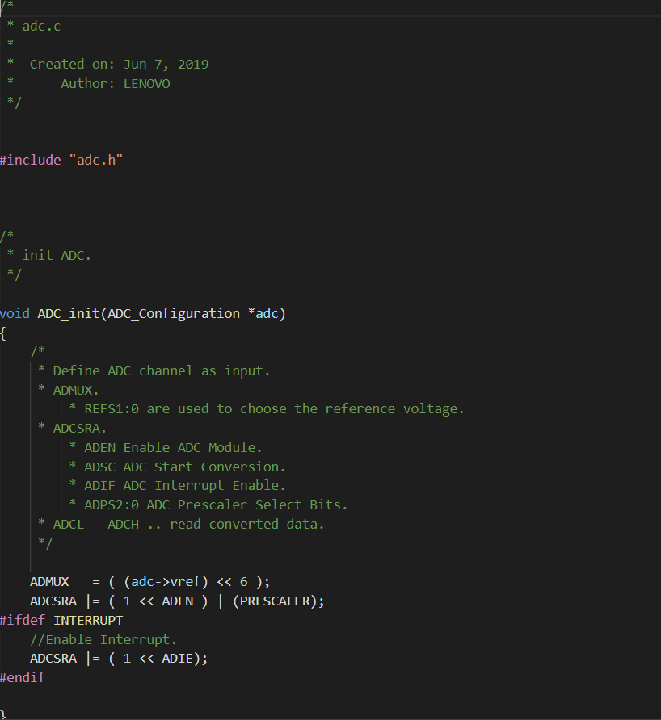
Our ADC Library For Atmega128 :

Slide 58
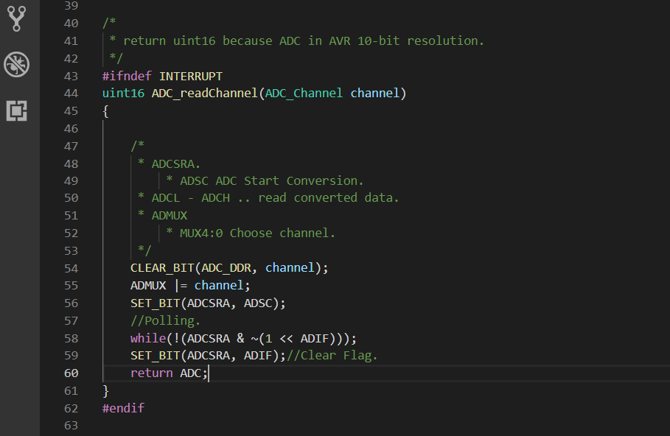

Slide 59
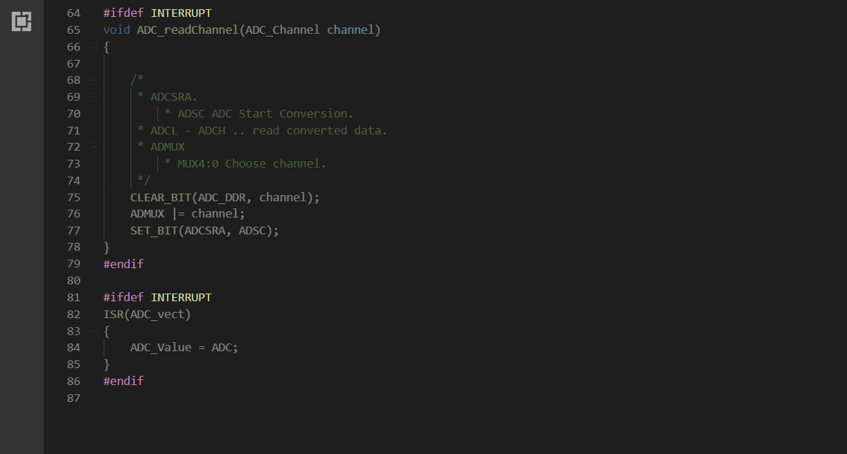

Slide 60


Slide 61
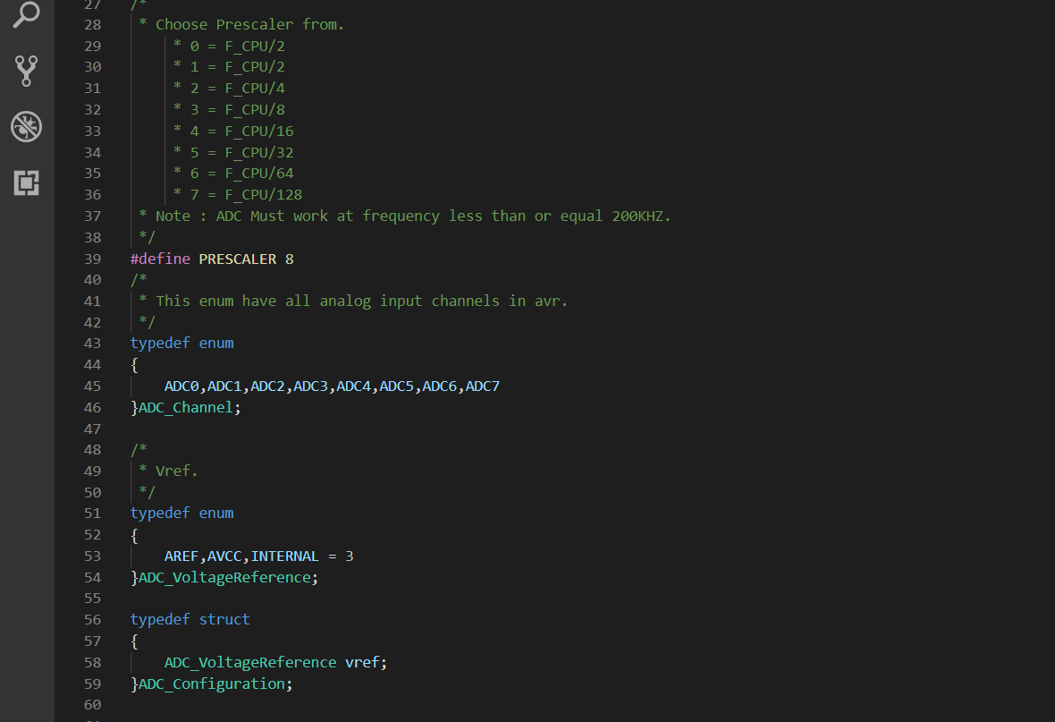

Slide 62
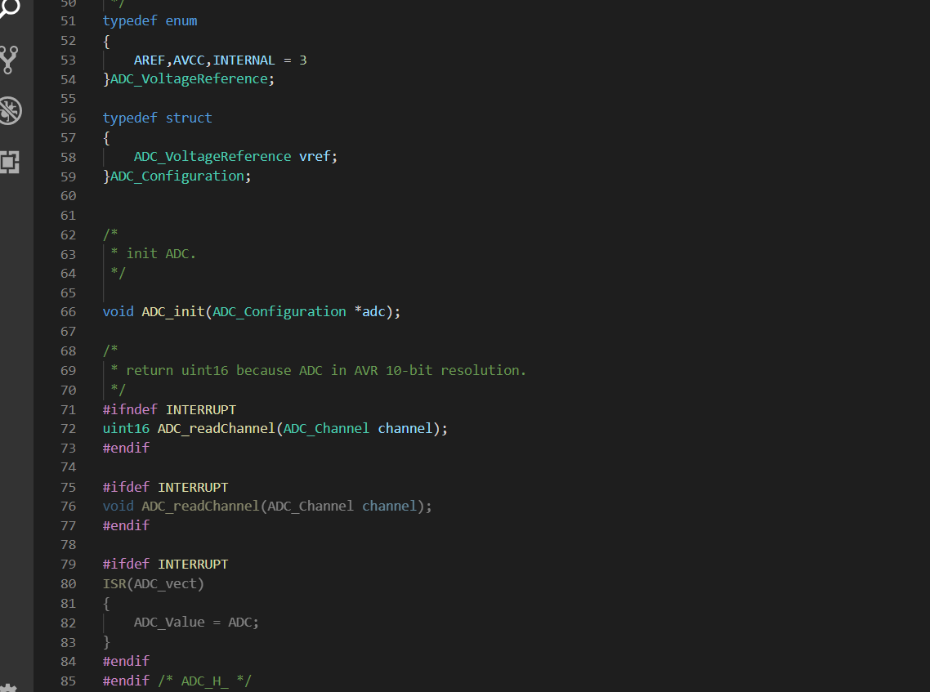

Slide 63
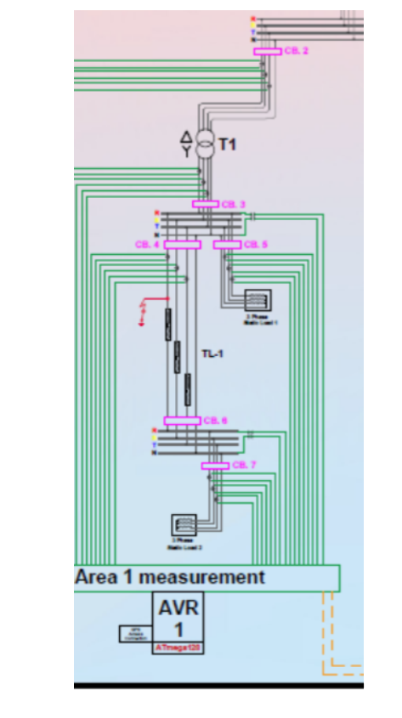
Our Algorithm Used To Synchronized Data.

Slide 64
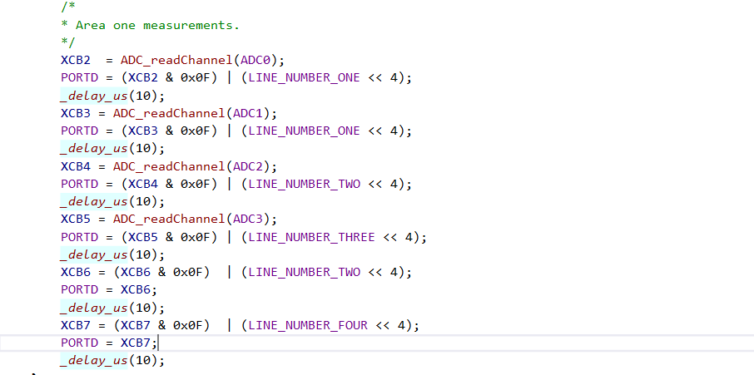

Slide 65
Delay in Communication.
Type of communication :
Series OR Parallel.
Frame Size:
In our project :
Parallel : No overhead In data .. it’s about (2 ms in our project).
Series:
Overhead In Data .. It’s about (10 ms in our project).
We Used UART Protocol.

Slide 66
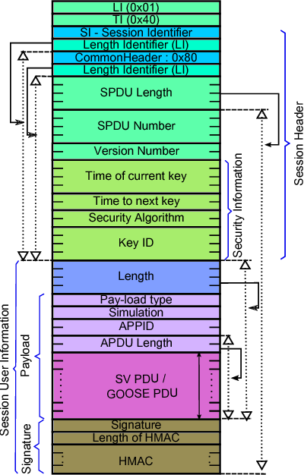
Frame In IEC 61850-90-5.

Slide 67
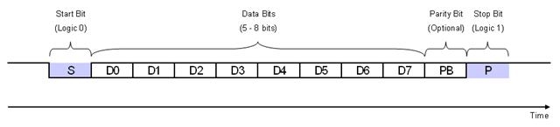
Frame In our project :
Serial Communication Frame :

Slide 68
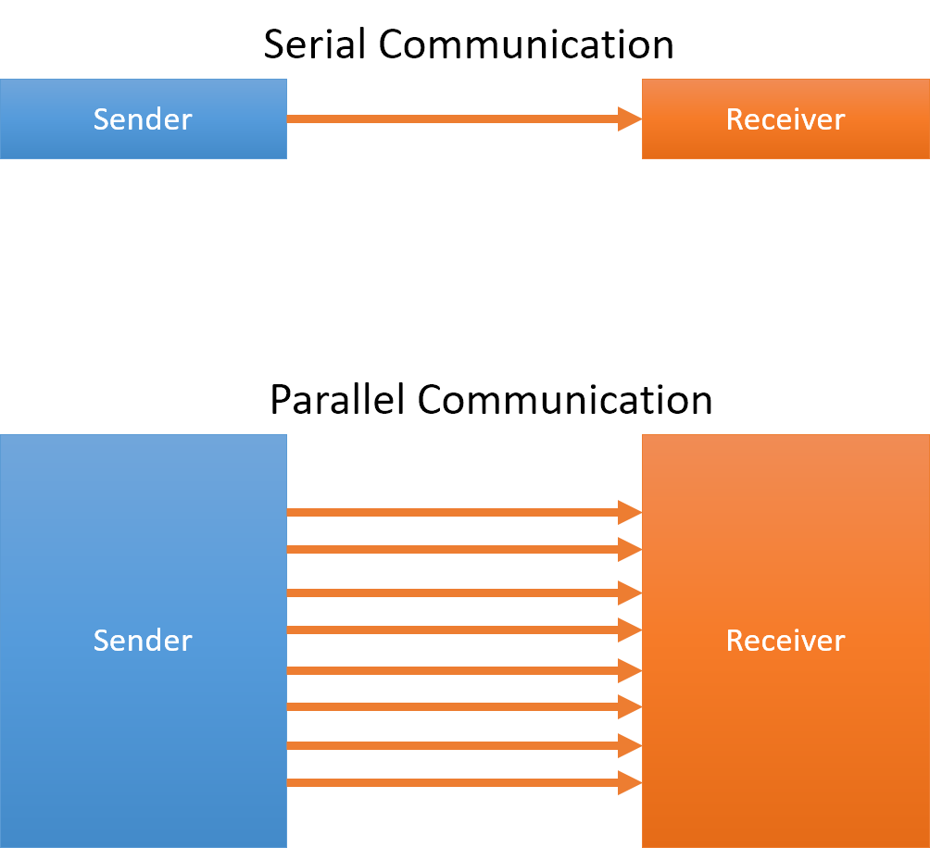
Parallel Communication Frame :

Slide 69
Thank You Any Questions ?

Slide 70
Graduation project
GPS module

Slide 71
GPS in WAP
the phasor, and, in particular, its phase-angle, is calculated using Coordinated Universal Time (UTC) as a time reference.
Such choice allows having a unique reference for all the sinusoidal signals to be measured in a wide or global area, because the time dissemination relies on satellite systems.

Slide 72
GPS in WAP
Two synchrophasors, calculated at different points in a network, can be easily compared because they are related to common instants.
In other words, the synchrophasor measured at a generic UTC reference time instant “Tr “represents the rms amplitude and the phase-angle of the sinusoidal signal at T .

Slide 73

GPS module”SKM55RM”

Slide 74

GPS module”SKM55RM”

Slide 75

GPS module”SKM55RM”

Slide 76
Hardware Interfaces Configuration
UART Ports:
The SKM55 series supports one full duplex serial channels UART.
The serial connections are at 2.85V LVTTL logic levels, if need different voltage levels, use appropriate level shifters. the data format is however fixed: X, N, 8, 1, i.e. X baud rate, no parity, eight data bits and one stop bit, no other data formats are supported, LSB is sent first. The modules default baud
rate is set up 9600bps.

Slide 77
Hardware Interfaces Configuration
RS232 Ports:
The SKM55 series uses single-chip RS232 to UART bridge, It is 3V powered EIA/TIA-232 and V.28/V.24 communication interfaces with low power requirements.

Slide 78

Hardware Interfaces Configuration

Slide 79

RS232 protocol to TTL protocol
*Using max232 IC as logic shifter.

Slide 80

MAX232 connection
Using Atmega 128 instead of Arduino in our case.

Slide 81
Software Protocol
NMEA 0183 Protocol :
The NMEA protocol is an ASCII-based protocol,
records start with a “$ “and with carriage return/line feed.
GPS specific messages all start with $GPxxx where xxx
is a three-letter identifier of the message data that
follows.
NMEA messages have a checksum, which allows detection of corrupted data transfers.

Slide 82
Software Protocol
NMEA Record Description
GGA Global positioning system fixed data.
GLL Geographic position-latitude/longitude.
GSA GNSS DOP and active satellites.
GSV GNSS satellites in view .
RMC Recommended minimum specific
GNSS data .
VTG Course over ground and ground speed.
ZDA Date and Time

Slide 83
Software Protocol
GGA-Global Positioning System Fixed Data :
“$GPGGA,021514.000,2232.1799,N,11401.1823,E,1,6,1.25,84.0,M,-2.2,M,,*74 “.
This sentence contains the position, time and quality of the navigation fix.
“Nema protocol,UTC,Latitude,N,Longitude,E,PF,......”

Slide 84


Slide 85

Software layers

Slide 86

Software layers

Slide 87

Software code using embedded C

Slide 88

Software code using embedded C

Slide 89

Software code using embedded C

Slide 90

Software code using embedded C

Slide 91

Software code using embedded C

Slide 92

Software code using embedded C

Slide 93

Software code using embedded C

Slide 94


Slide 95


Slide 96
Graduation project
HMI modules

Slide 97

LCD LM016

Slide 98

LCD LM016

Slide 99

LCD LM016

Slide 100

LCD LM016

Slide 101

LCD LM016

Slide 102

LCD LM016

Slide 103

LCD LM016

Slide 104

LCD LM016

Slide 105

LCD LM016

Slide 106

LCD LM016

Slide 107

LCD LM016

Slide 108

LCD LM016

Slide 109

LCD LM016

Slide 110

LCD LM016

Slide 111
SMART TOUCH LCD

Slide 112

SMART TOUCH LCD

Slide 113


SMART TOUCH LCD

Slide 114


SMART TOUCH LCD

Slide 115

SMART TOUCH LCD

Slide 116

SMART TOUCH LCD

Slide 117

SMART TOUCH LCD

Slide 118

SMART TOUCH LCD

Slide 119


SMART TOUCH LCD

Slide 120

SMART TOUCH LCD

Slide 121


Embedded C programing code

Slide 122

Embedded C programing code

Slide 123
Graduation Project
(Final Discussion)
Under supervision :
Prof.Dr : Mohamed Elshaat Masoud.
Prof.Dr :Saeed ELMasry.
Prof.Dr : Mohiy Bahgat.
Presented By : Zeyad Khaled.

Slide 124
Wide Area Protection :
INTRODUCTION :
The growth of electrical power systems is a challenge for Energy Management Systems to ensure a safe and reliable operation, This situation originates the need for tools that help to visualize and control electrical system variables using high speed communications channels and accurate data, allowing the grid operator to estimate the state of the system in real time through mathematical calculations,, We can define Wide Area Systems as a Summation of small or large areas that are not connected directly to each other and are separated from each other and it have a large distance between each other and through Wide Area Protection system Real-Time data can be collected from all these Areas and then it can be shared to each other and then monitored at one place and then controlling the whole Area from the Control Station.

Slide 125
There are many defects in the traditional Protection schemes so we used the Wide Area Protection as a Back-up Protection and these reasons are as follow :
1- Modern power systems are in the process of continuous development which has led to complex interconnected Networks, Financial pressure on the electricity market and on grid operators forces them to maximize the utilization of high voltage equipment, which very often lead their operation closer to the limits of the system, This approach of ensuring economic operation is possible provided the system is equipped with a well-designed and coordinated protection and control strategy to deal with wide spread disturbances in the system.

Slide 126
2-Traditional power system protection and control measures are based on local measurements, However, it is quite difficult to maintain the stability and security of the system on the whole, if only local measurements are employed in the protection and control schemes,, One promising way is to provide a system wide protection and control, complementary to the conventional local protection strategies, While it is not possible to predict or prevent all contingencies that may lead to power system collapse, a wide-area monitoring and control system that provides a reliable security prediction and optimized coordinated action is able to mitigate or prevent large area disturbances, The main tasks, which can be accomplished through wide-area based monitoring and control.

Slide 127
3- Conventional Problems happened because of many things like false tripping or not tripping at all and all of these problems can cause at some times serious problems that may lead to disasters and these problems should be controlled and isolated once it happened and for example,, The distance relays which are widely used in the protection nowadays and it involve the determination of impedance achieve operating times of the order of a period of the power system frequency, A distance relay is designed to only operate for faults occurring between the relay location and the selected reach point, and remains stable for all faults outside this region or zone, Consider that a fault with a resistance happened to this zone of the Distance Relay then what will happen?
The resistance of the fault arc takes the fault impedance outside the relay’s tripping characteristic and, hence, it does not detect this condition. Alternatively, it is only picked up either by zone 2 or zone 3 in which case tripping will be unacceptably delayed, The distance relays are based on standalone decision, while each relay operates independently according to three different zone of operation.

Slide 128
Wide Area Protection as a Back-up Protection :
Wide-area protection and its development : WAPS are focused on two fields: First is security, stability and control, Second is the relay protection, In the security and stability control field,, WAPS is mainly used to prevent long-term voltage collapse It is established on basis of the supervisory control and data acquisition (SCADA) system, with centralized decision-making structures, non-real-time data collection, and slow data refresh frequency, The communication system does not require fast, real-time data exchange,, Compared to the traditional strategies of stability control, WAPS involves a wider geographical scope and requires more complex calculations in the processes of getting information, forming control strategies, and carrying out control measures.

Slide 129

In the relay protection field, It uses globe positioning system (GPS) signals for precise time synchronization with using PMU devices and then collect all these data from these Devices and send it to PDC, and a dedicated fiber channel for multi-point current information transmission, And it can be easily make a backup protection for the system and avoid traditional problems.

Slide 130

The communication of data among them is carried via optic-fiber networks, The relay decision is based on collected and shared data through communication network. The suggested technique satisfies high degree of reliability and stability while it is based on shared decision rather than standalone decision. The suggested technique can see all the power system area and can deal with the transmission lines as unit protection.

Slide 131
While Traditional protection relays and devices operate through slow times, and these actions are certainly uncoordinated, Coordinated actions will be taken through SCADA/EMS systems by operators, however in prolonged times, which might make the situations too late to rescue,, Wide Area Protection (WAP) systems provide a very promising future in the face of wide-area disturbances and blackouts,, Phasor measurement technologies now allow accurate comparison of measurements over widely separated locations as well as potential real-time measurement based control actions. Hence WAP systems could be employed to fulfill the two main objectives of increasing transmission capability as well as increasing system reliability, by performing a real-time, look ahead analysis giving some recommendation of possible updated control strategies and actions, especially in the events of contingencies. The WAP system shall know what actions to take based on the present system condition in the case that a certain contingency occurring, or would take an action saving the system progressing into an unstable state.

Slide 132

The Wide Area protection and control are exist at bay, substation and regional levels, Covering both transmission and distribution networks, the system is supported by the proposed high speed synchronized communication network and the real-time protection and control information platform, The system section techniques and the latest developments in control system, offers not only fast protection, but also complete control of entire power network.

Slide 133
Wide Area Monitoring is the first step of Wide Area Protection:
The Wide Area Monitoring System (WAMS) consists of geographically dispersed Phasor Measurement Units (PMUs) delivering Synchrophasors, i.e., time-tagged data samples of a power system’s sinusoidal voltage or current using a standard time signal as the reference, to Phasor Data Concentrators (PDCs), These (PDCs) perform the desired signal handling and assembly of synchronized Phasor measurements into snapshots. They may also facilitate long term storage in high-resolution historical archives. The data in each PMU are time Synchronized to Universal Coordinated Time (UTC),, (WAM) became one of the most recent technologies that are popular for upgrading the traditional electric grid, This upgrade has become a necessity to modernize the electricity delivery system following the occurrence of major blackouts in power systems around the world

Slide 134

Wide Area Monitoring Systems collect the information from the power system, analyze the data and interpret the result, giving “warnings” to the system operator or initiating “defense schemes” in order to prevent stability problems,, WAMS consist of the 3 major components: Phasor Measurement Unit (PMU), Phasor Data Concentrator (PDC) and communication channel.

Slide 135

Applying Wide Area Protection as a back-up Protection for the whole system :
Blackouts and load shedding are major problems faced in the current world. These can be avoided by properly monitoring and controlling the existing power grid. Proper monitoring and controlling of power grid can be done using a PMU, The parameters measured using PMUs can be transmitted throughout the network, Smart grid is a modernized power grid that uses digital processing and communication technology to detect and react to local changes in the network thus providing stable and quality power at affordable rates.

Slide 136
Thus fault detection is improved and allows self-healing using state estimation, The information from the grid must be obtained in a synchronized manner in order to ensure uniform distribution of power over a large area. PMUs are installed throughout the transmission side of the grid and these monitor the state of the electrical network. These networks of PMUs are called WAMS, These PMUs are time synchronized using GPS. PMUs provide phasor parameters of the signal. It monitors the status of the switches, status of the circuit breakers, equipment performance, congestion, outages and demand response events, At first implementing the PMUs at the System with an algorithm of using PMUs at 25% of the number of the existed buses at the whole system.

Slide 137
Conventional protection schemes and a wide-area backup protection system :
According to recent studies, the mal-operation or fail-to trip of protection is determined as one of the origins to raise and propagate major power system disturbances. A vast majority of relay mal-operations are unwanted trips and have been shown to propagate major disturbances. A CIGRE study found that 27% of bulk power system disturbances resulted from false trips of the protection system. The major reason of these conventional solutions lies in that local protection devices are not considering a system view and are therefore not able to take optimized and coordinated actions. Backup protections in fault clearance system have the task to operate only when the primary protection fails to operate or when the primary protection is temporarily out of service. The recent complexity and enlargement of power systems makes it difficult to coordinate operation times and reaches among relays

Slide 138
Especially, In the existed relay protection system, mal operations of backup protection contribute a lot to system security and stability; furthermore, they are main reasons to system cascade tripping, To solve this problem, one proposal is to add an intelligent analyzing and controlling function in key process of protection functionality, In the areas of power system automation and substation automation, there are two different trends: centralization and decentralization. More and more dynamic functions are moving from local and regional control centers toward central or national control centers. At the same time we also observe more "intelligence" and "decision power" moving closer towards the actual power system substations. Greater functional integration is being enclosed in substation hardware. In view of global security of power systems, the action algorithms of conventional backup protections possibly are not best choices because the operations of individual relays are hardly coordinated each other. Therefore, the principle of the protection design needs innovation to overcome the above problem.

Slide 139

The proposed system comprises a master system and several local units. The system is arranged as three layers. The bottom layer consists of PMUs with additional protection functionality. The next layer consists of several Local Backup Protection Centers (LBPCs), each of which interfaces directly with a number of PMUs. The top layer, System Backup Protection Center (SBPC), acts as the coordinator for the LBPCs. Connected together via fiber-optic communication links.

Slide 140
The proposed system comprises a master system and several local units. The system is arranged as three layers. The bottom layer consists of PMUs with additional protection functionality. The next layer consists of several Local Backup Protection Centers (LBPCs), each of which interfaces directly with a number of PMUs. The top layer, System Backup Protection Center (SBPC), acts as the coordinator for the LBPCs. Connected together via fiber-optic communication links, these devices can process intelligent algorithms based on data collected locally, Local part of the proposed wide-area backup system comprises PMUs and LBPC, which are both installed in the station, PMUs are made up of DSP (Digital Signal Processor) and GPS(Global Positioning System). The DSP measures instantaneous voltages and currents of protected power system in real-time, and calculates the state variables, which provide vital information for backup protection system.

Slide 141
Then, power system variable data is transferred to LBPC, LBPC samples digital inputs, and pre-processes the analog and digital signals, and then deliver preprocessed results to SBPC via fiber-optic communications between the substation and SBPC. SBPC will be installed at Regional Control Center, and integrates various well-developed functions, such as data acquisition via communication, system monitoring, fault location, security analyzing, making tripping strategy and descending strategy to LBPCs, also, SBPC can do post-event playback and post-event data analyses. These functions employ PMUs to fulfill real-time demand,, LBPCs perform the correlative operations on the spot when receiving the strategy from SBPC, then fault will be isolated rationally. While it is not possible to prevent all contingencies that may lead to power system collapse, a wide area backup protection system that provides a reliable security isolated scheme and optimized coordinated actions is able to mitigate or prevent large area disturbances.

Slide 142
The End.

